Slide 1


TIME SERIES -BASED ELECTRICITY CONSUMPTION
BY
HATLIN JOHEIT J A
(22PDS807)
INTERNAL GUIDE
Dr. V. ARUL KUMAR M.Sc, M.Phil., Ph.D., SET
Assistant professor
Department of Data Science
EXTERNAL GUIDE
MR. SYED ASAD AHMED
CEO & Chief AI Engineer
Airobosoft product and services
Bangalore, Karnataka

Slide 2
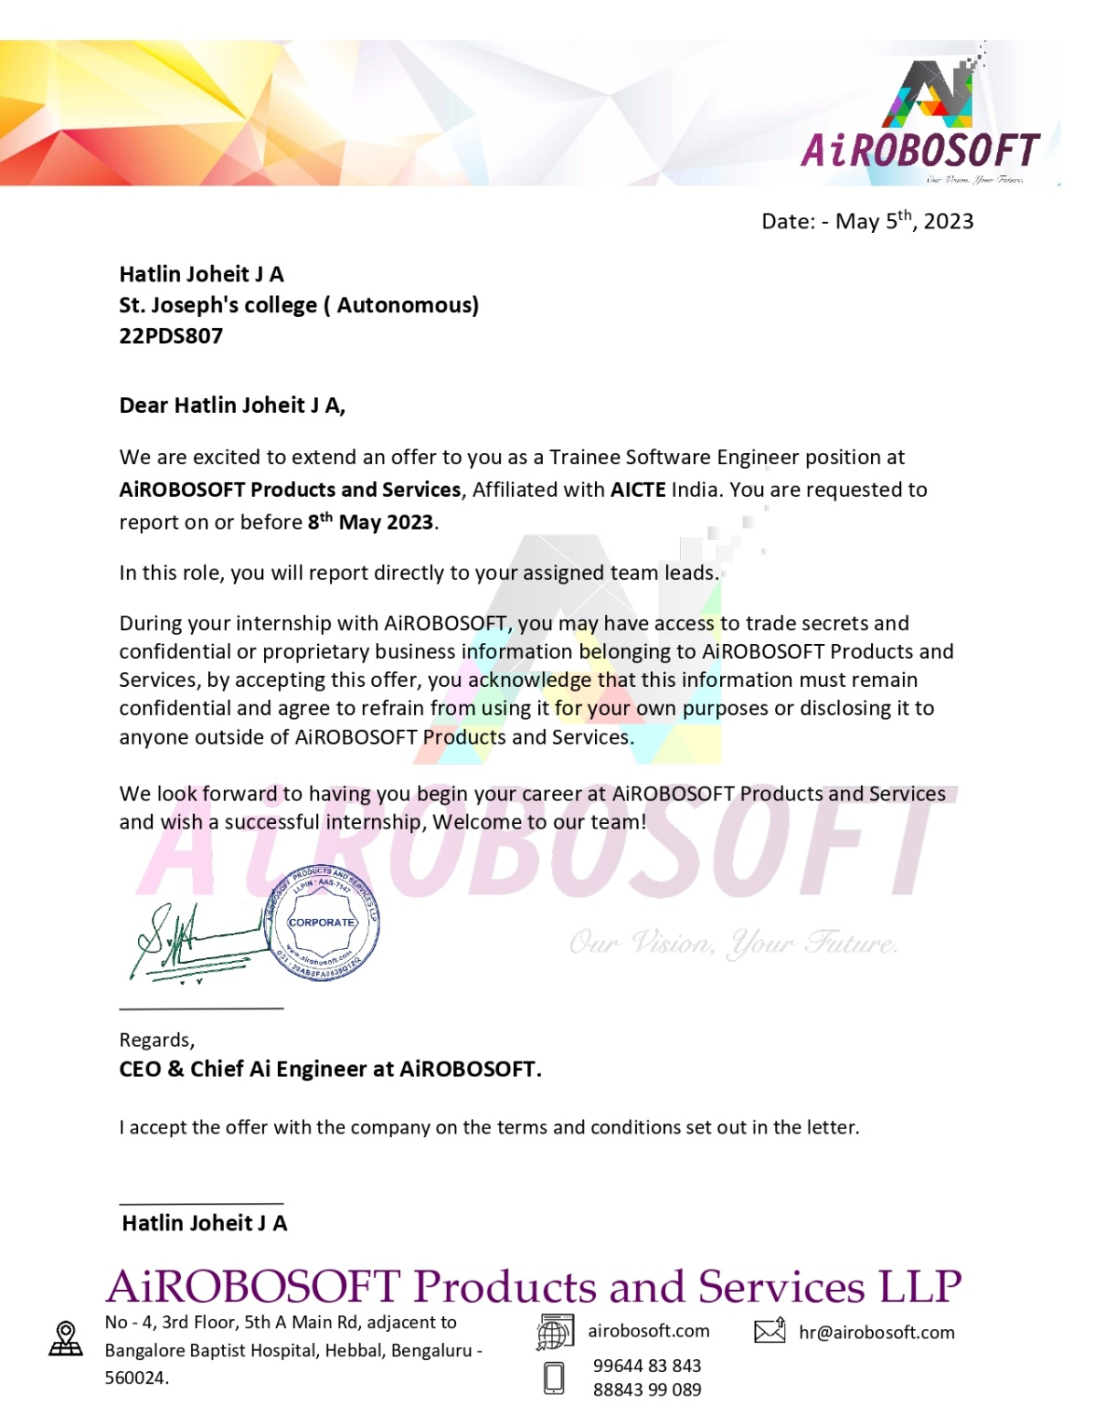
Acceptance Letter
AIROBOSOFT PRODUCT AND SERVICES
is a Bangalore based IT firm leading a team of Data Scientist, Robotics & Electronics Engineers, experts in Machine Learning and more, collaborated together to work on fascinating futuristic technologies.

Slide 3

Completion Certificate

Slide 4
Agenda
Introduction
Company Profile
Problem statement
Background work
Data description
Tool Used & Technology Adopted
Solution for the Problem
Workflow
Conclusion
Reference

Slide 5
Introduction
Electricity consumption refers to the amount of electrical energy used by various devices, appliances, and systems. It is a measure of the quantity of electricity consumed over a specific period of time.
Electricity consumption using time series in machine learning refers to the application of machine learning techniques to analyze historical data of electricity consumption over time.

Slide 6

Company Profile
AIROBOSOFT PRODUCT AND SERVICES is a Bangalore based IT firm leading a team of Data Scientist, Robotics & Electronics Engineers, experts in Machine Learning and more, collaborated together to work on fascinating futuristic technologies.
Website : http://www.airobosoft.com
Headquarters : Bangalore, Karnataka
Specialties : Robotics, Artificial intelligence, Machine Learning, IOT, and Software development
LinkedIn Profile link : https://www.linkedin.com/company/airobosoft-products-and-services/about/

Slide 7
Problem statement
The aim to analyze electricity consumption patterns using time series analysis techniques. The goal is to gain insights into the temporal behavior of electricity consumption, identify trends, seasonality, and any other patterns, and potentially develop a forecasting model for future electricity consumption.
Through the utilization of time series analysis, governments can effectively capture the recurring patterns in electricity usage on a daily, weekly, and seasonal basis.

Slide 8
Background work
The dataset is given by the Company.
Installed Anaconda Jupyter notebook for the project as open- source software available in the internet for free.
After importing the dataset, it consisted of little bit noise data later it was been removed by data preprocessing.
After cleaning the data, the selection of machine learning model was been predicted.
The dataset was splitted into train and test dataset, later it was been evaluated

Slide 9
Dataset description
Dimension of the data set: 4993 records and 2 attributes
It is a Primary data
Attributes:
Datetime
Megawatt

Slide 10




Tools, library used and technology adopted
Time Series & Machine learning
TOOLS USED:
Pandas
Scikit-learn
Prophet
Statsmodels

Slide 11
Solution for the problem
The necessary libraries required are been imported.
Checked if is any noisy data in the dataset and cleared all the noisy data.
The input features are then used to train the different machine learning models.
Each dataset is divided into training and testing set.
After training the dataset predict the dependent variable using time series modeling.
After creating the model, the prediction is been done to find the accuracy of the model.

Slide 12
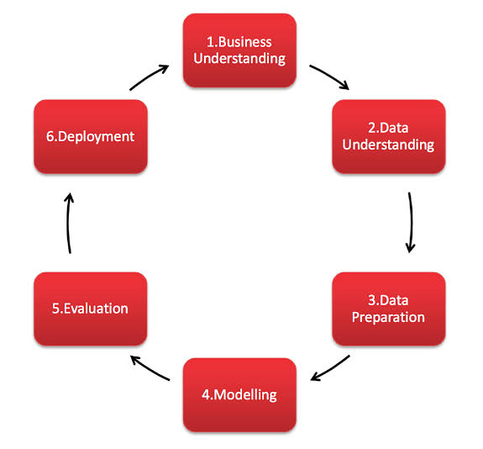
Workflow

Slide 13
Data preprocessing
Missing data
Dealing with Missing Data upon examining the dataset, it was determined that there are no missing values present.
Converting to Suitable Data Types
The date-time attribute was initially identified as an object variable. Therefore, it was transformed into the appropriate Date-time data type.

Slide 14
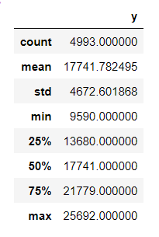
Data exploration
SUMMARY OF THE DATA:
The dataset contains 4993 observations.
The average (mean) value of the target variable (kilowatt) is 17741.7825
The standard deviation of the target variable is 4672.601868, indicating a moderate degree of variability in the data.
The minimum value of the target variable is 9590, while the maximum value is 25692, indicating a relatively wide range of values.
The 50th percentile (also known as the median) of the target variable is 17741, indicating that half of the observations have kilowatt values below this value.
Megawatt

Slide 15
Modeling
ARIMA (Auto-Regressive Integrated Moving Average)
The ARIMA model is a statistical method for time series analysis. It models the dependencies in the data and can be used for forecasting future values.
Prophet
Prophet is a time series forecasting library developed by Facebook's Core Data Science team. It's easy to use, flexible, and accurate.

Slide 16
Model evaluation
The MAE value of 4142.1 indicates that on average, the ARIMA model's predictions are off by about 4142.1 units from the actual values. There is a Lower MAE value which indicates a better fit of the model to the data.
The MAE value of 4144.1 indicates that on average, the Prophet model's predictions are off by about 4144.1 units from the actual values. There is a Lower MAE value which indicates a better fit of the model to the data.

Slide 17
Conclusion
In conclusion, the ARIMA model was a suitable approach for predicting future electricity consumption, and our results can provide valuable insights for governments to plan for emergencies and transitions to renewable energy sources.

Slide 18
Reference
https://towardsdatascience.com/time-series-forecasting-with-machine-learning b3072a5b44ba?gi=97f5661f25cd
https://www.analyticsvidhya.com/blog/2021/10/a-comprehensive-guide-to-time-series-analysis/
https://docs.aws.amazon.com/forecast/latest/dg/aws-forecast-recipe-prophet.html
https://neptune.ai/blog/arima-vs-prophet-vs-lstm

Slide 19

Thank You

